Slide 1

Prediction of Ignition Delay Time Characteristics of Natural Gas Mixture Using Machine Learning Models
Rushil Mital
2021ES10184
Under the guidance of
Prof. Snehasish Panigrahy
Indian Institute of Technology, Delhi
Department of Energy Science and Engineering

Slide 2
Abstract
Notes:
Hydrogen-compatible gas turbines present a viable solution for decarbonizing electricity generation. However, the combustion and handling of hydrogen are non-trivial due to its high reactivity and propensity to detonate. Critical safety parameters, such as auto-ignition delay times, can be predicted using detailed kinetic models. However, the computational expense of such models poses a challenge for their integration with fluid dynamics simulations. To address this, an auto-ignition prediction tool was developed based on an artificial intelligence (AI) model, allowing for rapid computations and its integration into an explosion model.

Slide 3
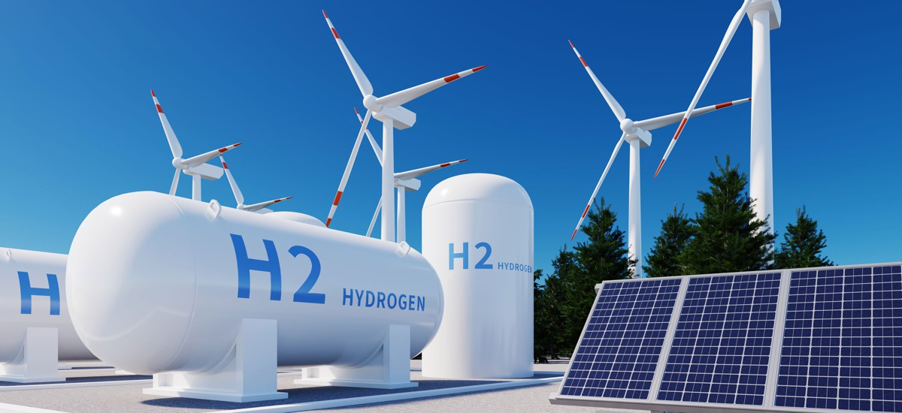
Abstract
Notes:
Hydrogen-compatible gas turbines present a viable solution for decarbonizing electricity generation. However, the combustion and handling of hydrogen are non-trivial due to its high reactivity and propensity to detonate. Critical safety parameters, such as auto-ignition delay times, can be predicted using detailed kinetic models. However, the computational expense of such models poses a challenge for their integration with fluid dynamics simulations. To address this, an auto-ignition prediction tool was developed based on an artificial intelligence (AI) model, allowing for rapid computations and its integration into an explosion model.

Slide 4
Literature Review

Slide 5
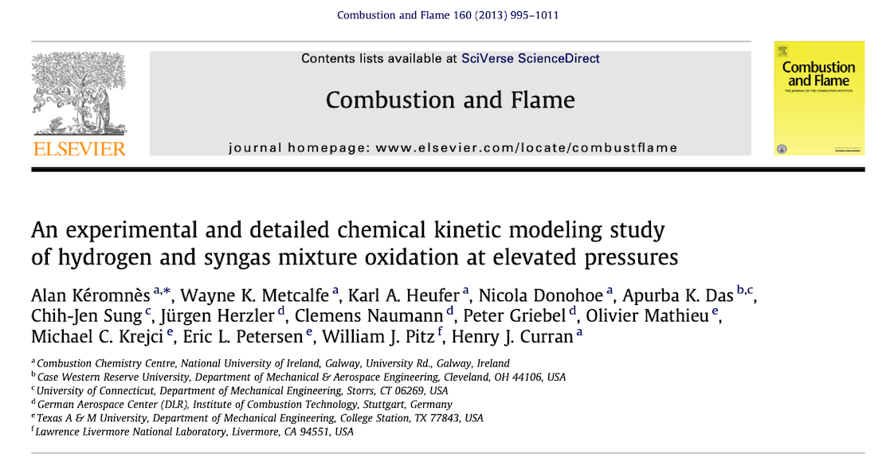
Topics Discussed
Hydrogen as a fuel
Syngas Combustion
Flame Speed and Ignition Delay Times
Chemical Kinetic Modelling

Slide 6

Topics Discussed
Reaction Mechanisms of Combustion
Presence of oxygenated hydrocarbons and carbonyls
Properties of combustion predicted via mechanism
Hierarchical mechanisms

Slide 7
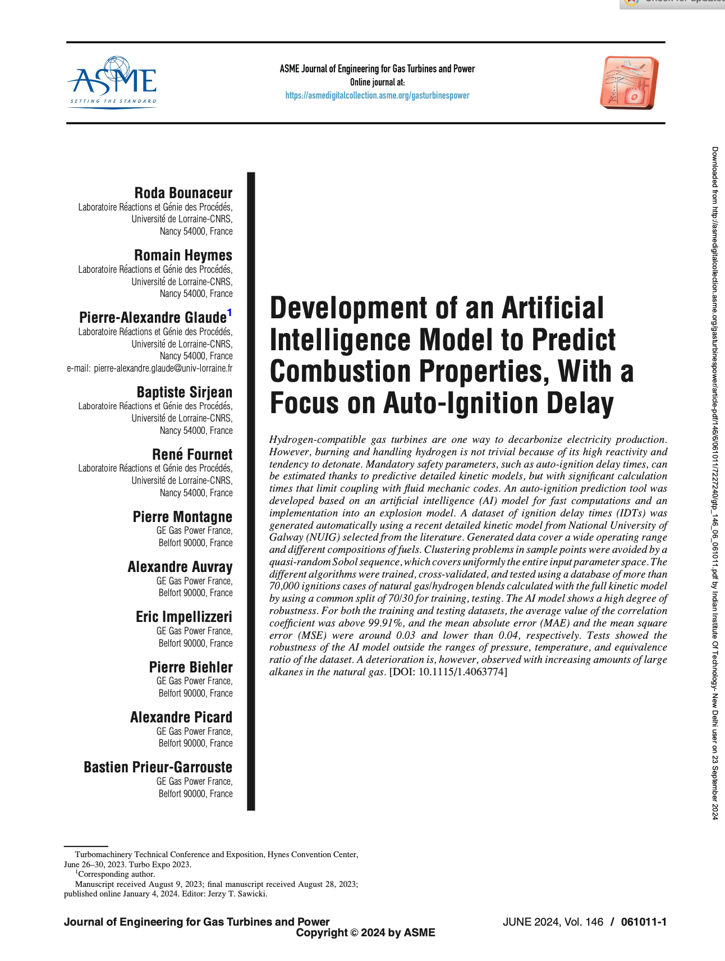
Topics Discussed
Need for prediction of IDT for Hydrogen
Models to predict auto-ignition properties
KNN, SVR, RF, ANN
Suitable for smaller alkanes

Slide 8
Methodology

Slide 9
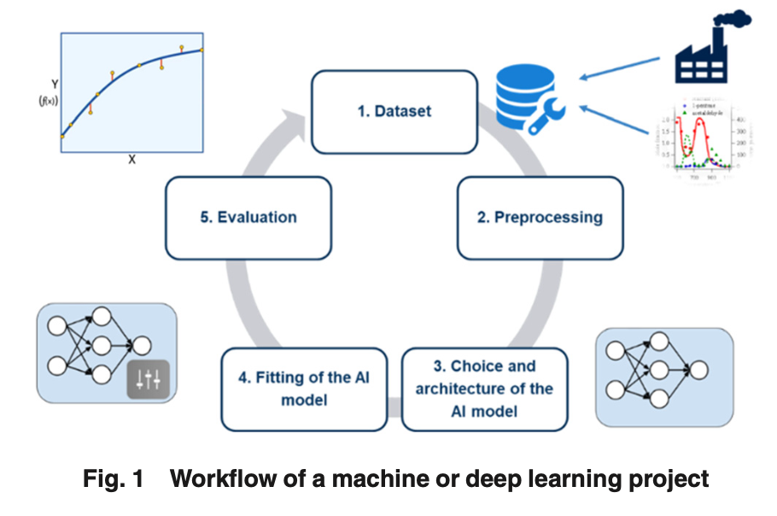
Source: https://asmedigitalcollection.asme.org/gasturbinespower/article/146/6/061011/1169382

Slide 10
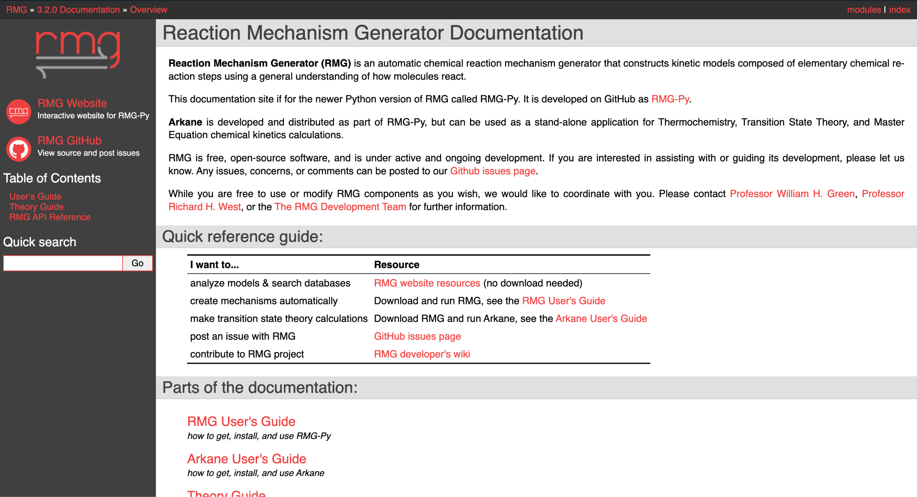

Slide 11
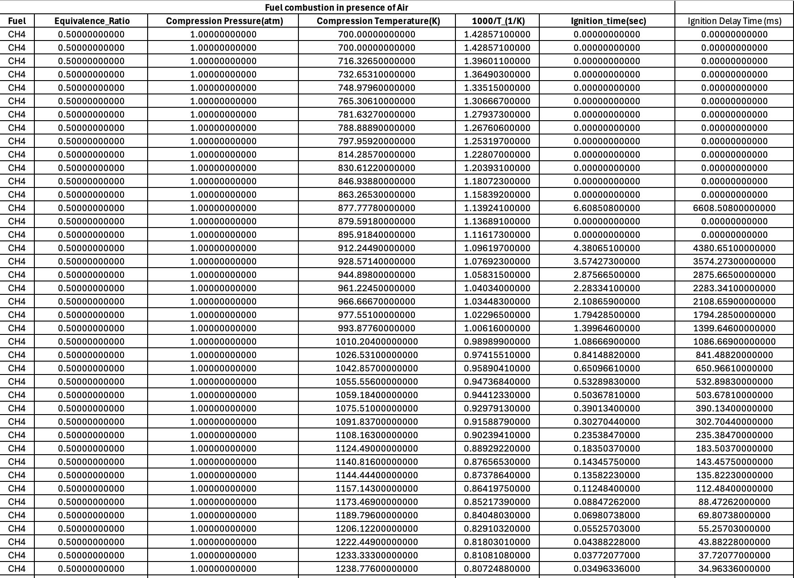

Slide 12
Results and Discussions

Slide 13
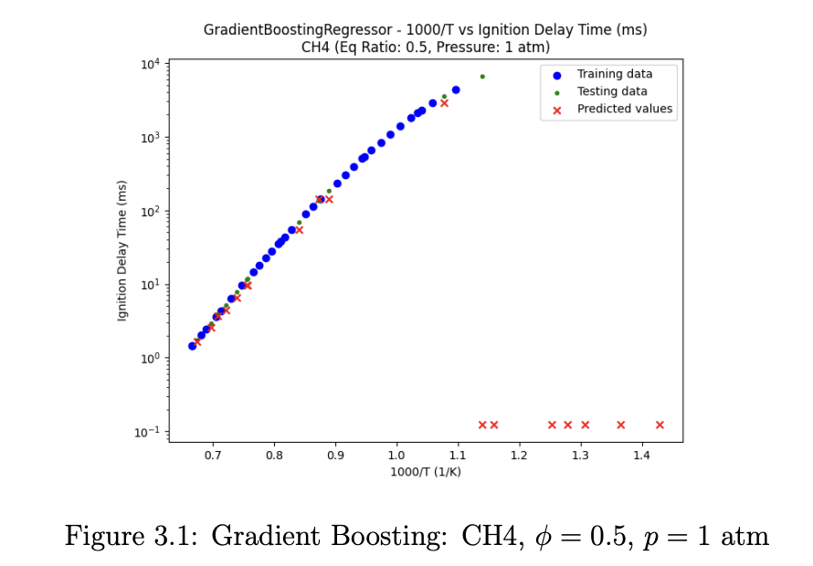

Slide 14
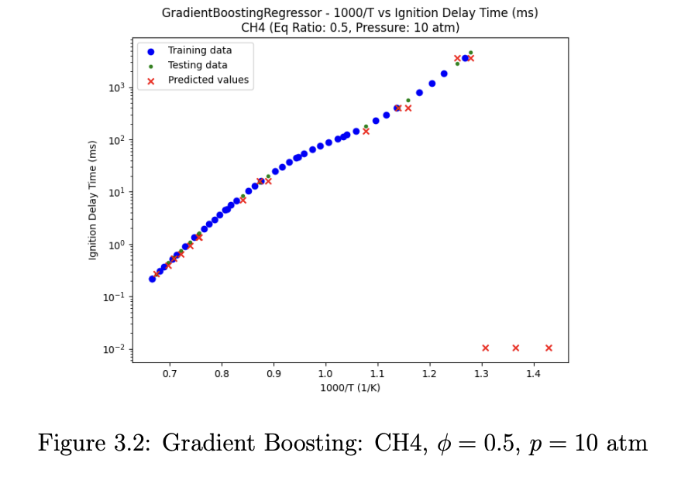

Slide 15
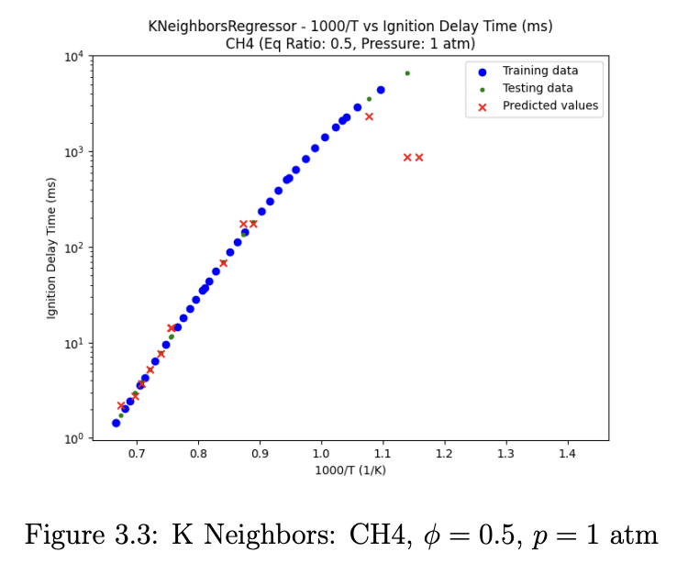

Slide 16
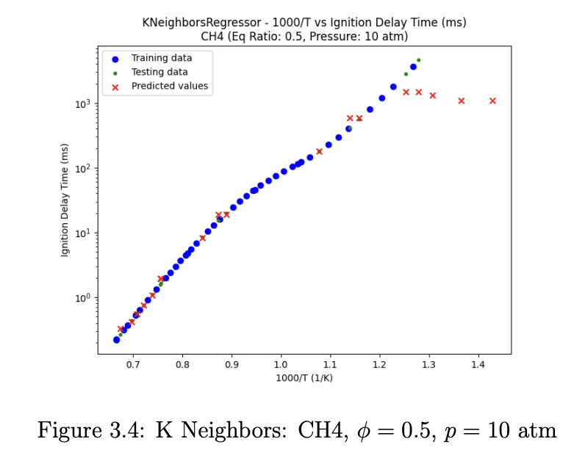

Slide 17
Potential Sources of Errors

Slide 18
K-Nearest Neighbors (KNN)
High Sensitivity to number of neighbours (n)
Risk of overfitting and underfitting
Poor generalization due to noise

Slide 19
Gradient Boosting
Prone to overfitting
Dependence on learning rate (α) , may result in very early convergence or no convergence
Models are sequential, errors propagate from one tree to the next, may result in amplification

Slide 20
Multi-Layer Perceptron (MLP)
Highly sensitive to the choice of hyperparameters like hidden layer sizes and the activation functions
’adam’ may not perform well on small datasets
Need for regularization techniques like dropout and weight decay

Slide 21
Decision Tree
Tend to overfit the data
Prone to instability
Overfitting very likely when pruning or regularization is not done

Slide 22
Random Forest
Computationally expensive
Difficult to understand the decision-making process
Can suffer from overfitting if individual trees are not too deep

Slide 23
Support Vector Regression (SVR)
Choice of the regularization parameter C and kernel function
Dependence on Radial Basis Function
Can be sensitive to the scaling of the input features

Slide 24
Scope of Further Work

Slide 25
Hyperparameter Optimization
Notes:
The performance of machine learning models is highly dependent on the choice of hyperparameters. To further improve the accuracy of our predictions, we plan to implement advanced hyperparameter optimization techniques such as Grid Search and Random Search. These methods allow for the systematic exploration of hyperparameter spaces to identify the optimal configurations for models like the MLP, Random Forest, and Gradient Boosting models. In particular, we will focus on tuning parameters such as the number of hidden layers, learning rate, and activation functions for the MLP model to minimize overfitting and enhance generalization. Additionally, optimization techniques like Bayesian Optimization and Genetic Algorithms could be explored to refine the model hyperparameters and expedite the search process.

Slide 26
Expanding the Dataset
Notes:
One limitation of the current study is the relatively small dataset used for model training and evaluation. Increasing the dataset size can significantly improve model robustness and reduce overfitting. Therefore, our future efforts will include gathering larger datasets that encompass a wider range of operating conditions, such as varying pressures, temperatures, and equivalence ratios. A larger dataset will also allow for better cross-validation and testing, providing more accurate insights into model performance across different conditions

Slide 27
Novelty: Working with fuel mixtures
Notes:
Thus far, the focus has been exclusively on methane (CH4), but in practical applications, fuel mixtures—such as those involving propane (C3H8) and methane—are common. Extending the models to predict IDT for mixtures of various hydrocarbons will be a key next step in our research. This will require not only additional data but also modifications to the models to handle the non-linearities and complexities introduced by multi-component fuel systems. For instance, fuel-specific characteristics such as flame propagation speeds and heat release rates will need to be incorporated into the models to accurately capture the combustion behavior of fuel mixtures.

Slide 28
Q&A

